Slide 1
Day - 2
Understanding the Data
10/10/2023
Measures of Central Tendency and Dispersion

Slide 2
The phrase “descriptive statistics” is used generically in place of measures of central tendency and dispersion for inferential statistics.
These statistics describe or summarize the qualities of data.
Another name is “summary statistics”, which are univariate:
  Mean, Median, Mode, Range, Standard Deviation, Variance, Min, Max, etc.

Slide 3
Measures of Central Tendency
These measures tap into the average distribution of a set of scores or values in the data.
  Mean
  Median
  Mode

Slide 4
What do you “Mean”?
The “mean” of some data is the average score or value, such as the average age of an MPA student or average weight of professors that like to eat donuts.
Inferential mean of a sample: X=(∑X)/n
Mean of a population: μ=(∑X)/N

Slide 5
Problem of being “mean”
The main problem associated with the mean value of some data is that it is sensitive to outliers.
Example, the average weight of political science professors might be affected if there was one in the department that weighed 600 pounds.

Slide 6
Donut-Eating Professors
Professor | Weight |  | Weight
Schmuggles | 165 |  | 165
Bopsey | 213 |  | 213
Pallitto | 189 |  | 410
Homer | 187 |  | 610
Schnickerson | 165 |  | 165
Levin | 148 |  | 148
Honkey-Doorey | 251 |  | 251
Zingers | 308 |  | 308
Boehmer | 151 |  | 151
Queenie | 132 |  | 132
Googles-Boop | 199 |  | 199
Calzone | 227 |  | 227
 | 194.6 |  | 248.3

Slide 7
The Median (not the cement in the middle of the road)
Because the mean average can be sensitive to extreme values, the median is sometimes useful and more accurate.
The median is simply the middle value among some scores of a variable. (no standard formula for its computation)

Slide 8
What is the Median?
Weight
132
148
151
165
165
187
189
199
213
227
251
308
Professor | Weight
Schmuggles | 165
Bopsey | 213
Pallitto | 189
Homer | 187
Schnickerson | 165
Levin | 148
Honkey-Doorey | 251
Zingers | 308
Boehmer | 151
Queenie | 132
Googles-Boop | 199
Calzone | 227
 | 194.6
Rank order and choose middle value.
If even then average between two in the middle

Slide 9
Percentiles
If we know the median, then we can go up or down and rank the data as being above or below certain thresholds.
You may be familiar with standardized tests. 90th percentile, your score was higher than 90% of the rest of the sample.

Slide 10
The Mode (hold the pie and the ala)
(What does ‘ala’ taste like anyway??)
The most frequent response or value for a variable.
Multiple modes are possible: bimodal or multimodal.

Slide 11
Figuring the Mode
Professor | Weight
Schmuggles | 165
Bopsey | 213
Pallitto | 189
Homer | 187
Schnickerson | 165
Levin | 148
Honkey-Doorey | 251
Zingers | 308
Boehmer | 151
Queenie | 132
Googles-Boop | 199
Calzone | 227
What is the mode?
Answer: 165
Important descriptive information that may help inform your research and diagnose problems like lack of variability.

Slide 12
Measures of Dispersion (not something you cast…)
Measures of dispersion tell us about variability in the data. Also univariate.
Basic question: how much do values differ for a variable from the min to max, and distance among scores in between. We use:
  Range
  Standard Deviation
  Variance (standard deviation squared)

Slide 13
To glean information from data, i.e. to make an inference, we need to see variability in our variables.
Measures of dispersion give us information about how much our variables vary from the mean, because if they don’t it makes it difficult infer anything from the data. Dispersion is also known as the spread or range of variability.

Slide 14
The Range (no Buffalo roaming!!)
r = h – l
  Where h is high and l is low
In other words, the range gives us the value between the minimum and maximum values of a variable.
Understanding this statistic is important in understanding your data, especially for management and diagnostic purposes.

Slide 15
The Standard Deviation
A standardized measure of distance from the mean.
In other words, it allows you to know how far some cases are located from the mean. How extreme our your data?
68% of cases fall within one standard deviation from the mean, 97% for two deviations.

Slide 16
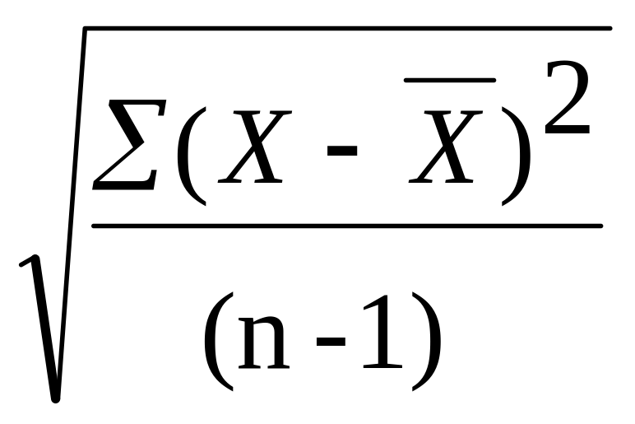
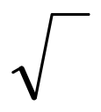
Formula for Standard Deviation
S =
=square root
∑=sum (sigma)
X=score for each point in data
_
X=mean of scores for the variable
n=sample size (number of observations or cases

Slide 17
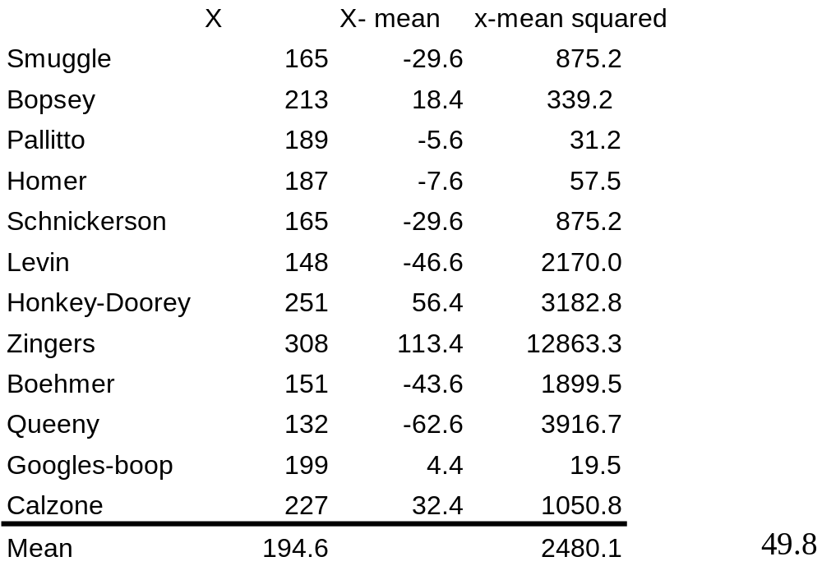
We can see that the Standard Deviation equals 165.2 pounds. The weight of Zinger is still likely skewing this calculation (indirectly through the mean).

Slide 18
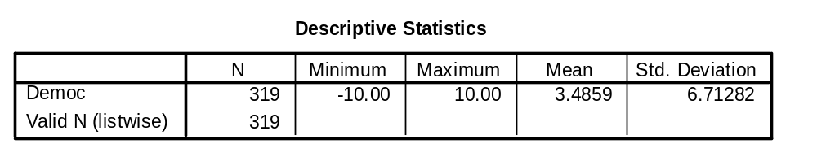
Std. Deviation practice
What is the value of Democracy one std. deviation above and below the mean?
The answer is 10.20872 and -3.22692
What percentage of all the cases fall within 10.2 and -3.2?
Roughly 68%

Slide 19
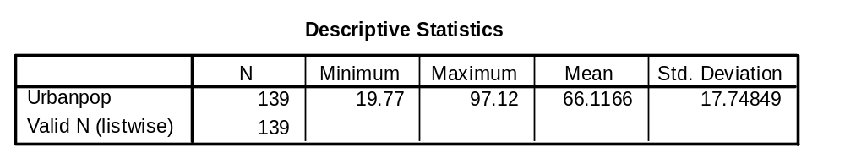
Std. Deviation practice
What is the value of Urban population one std. deviation above and below the mean?
The answer is 83.86509 and 48.36811
What percentage of all the cases fall within 83.86 and 48.36?
Roughly 68%

Slide 20
Creating Frequencies
We create frequencies by sorting data by value or category and then summing the cases that fall into those values.
How often do certain scores occur? This is a basic descriptive data question.

